Slide 1





PROJECT PRESENTATION
GROUP 3 – T1.2109E0
Symphony limited
Team Member:
Leader: Đào Bùi Quang Hưng
Members: Mai Quốc Tuấn
Lê Quốc Trung
Instructor: Nguyễn Kim Thuần

Slide 2
Content
Introduction
Requirement
Sitemap
Test result
Task list

Slide 3
introduction
Currently, there are many different training centers and institutes for information technology so Symphony Ltd. is private institute, which generally conducts the classes and training materials for the various certifications that are related to IT and Software industries like networking related, Java related, database related like for SQL Servers, oracle, etc. They are one of the famous institutions which have spread in to various branches situated at different location in the state. They provide various resources like the preparation materials, lab facilities based on the subject, extra lab hours or sessions (offered after the course duration), 24 hours faculty guidance is provided for the lab sessions, assignments, Library facilities, etc.

Slide 4
requirements
Student | Admin
View information about the institution View information about the courses View upcoming exams View result View FAQ’s View list of centres | Login: View/Enter Courses (+ New) Enter Entrance Examination Information Enter student information Enter or update information about the institution Enter/Update/Delete FAQs Enter/Update/Delete the list of centres

Slide 5
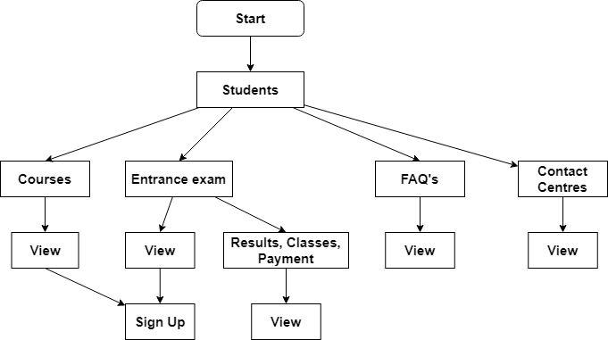
A. Student Sitemap

Slide 6
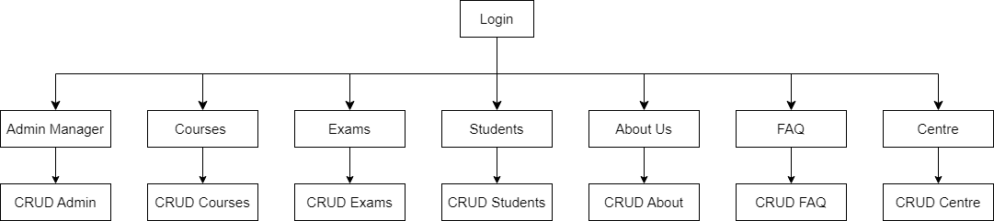
B. Admin Sitemap

Slide 8
Task list
Review 1
Members |  | Date Preparation Of Activity Plan
No | Name | Description Task | Start Date | End Date | Status
1 | Đào Bùi Quang Hưng | All | 04/12/2022 | 07/12/2022 | Completed
2 | Mai Quốc Tuấn | All | 04/12/2022 | 07/12/2022 | Completed
3 | Lê Quốc Trung | All | 04/12/2022 | 07/12/2022 | Completed

Slide 9
Task list
Review 2
Members |  | Date Preparation Of Activity Plan
No | Name | Description Task | Start Date | End Date | Status
1 | Đào Bùi Quang Hưng | Architecture, Database | 08/12/2022 | 16/12/2022 | Completed
2 | Mai Quốc Tuấn | Flowchart | 08/12/2022 | 16/12/2022 | Completed
3 | Lê Quốc Trung | Use Case | 08/12/2022 | 16/12/2022 | Completed

Slide 10
Task list
Review 3
Members |  | Date Preparation Of Activity Plan
No | Name | Description Task | Start Date | End Date | Status
1 | Đào Bùi Quang Hưng | Admin (Login/Logout/Authenticate/Management) Courses API Exams (App + API) Exam Result show | 17/12/2022 | 28/12/2022 | Completed
2 | Mai Quốc Tuấn | FAQ (API + App) About Us (API + App) | 17/12/2022 | 28/12/2022 | Completed
3 | Lê Quốc Trung | Student (API + App) Teacher (API + App) Centre (API + App) Course (normal site view) Home Page | 17/12/2022 | 28/12/2022 | Completed

Slide 11
Thank You

